Slide 1






SCALING SPEECH SYNTHESIS MODELS ON AWS
Niyathi Aiella
Tvisha Goswami
Nitin Jayan
Abhishek Nambiar
Amrit Singh

Slide 2
Agenda
1
Business problem and benefits
2
Business and analytical problem framing
3
Methodological Diagram and AWS Architecture
4
Model build and pipeline
5
Results and future scope

Slide 3




Business Problem
Adult illiteracy rate in Asian and Central African Countries is as high as 35%
According to WHO, as of 2020, about 36M people in the world were visually impaired
Audio is a much more convenient and efficient way for people to assimilate knowledge
Provide marginalized communities with better learning opportunities with language solutions

Slide 4




Business Benefits
GREATER ACCESSIBILTY
BETTER USER EXPERIENCE
BUILD VIRTUAL ASSISTANTS
HIGHER
CONVENIENCE
Easier access for people with vision impairment
More engaging for the users
Saves time and resources
Can listen to digital content on the go

Slide 5



Business To Technical Problem Framing
Speech synthesis models for various lesser-known languages
Incorporate Montreal Forced Aligner
and Coqui TTS
Scalable and reproducible AWS pipeline
Audio pipeline is set to give a TTS model within ~6 Hrs.
Input Text
Speech synthesis model
Speech Output

Slide 6






AWS Well-Architected Framework
Performance Efficiency
Security
Reliability
Operational Excellence
Cost Optimization
Well –Architected Framework

Slide 7
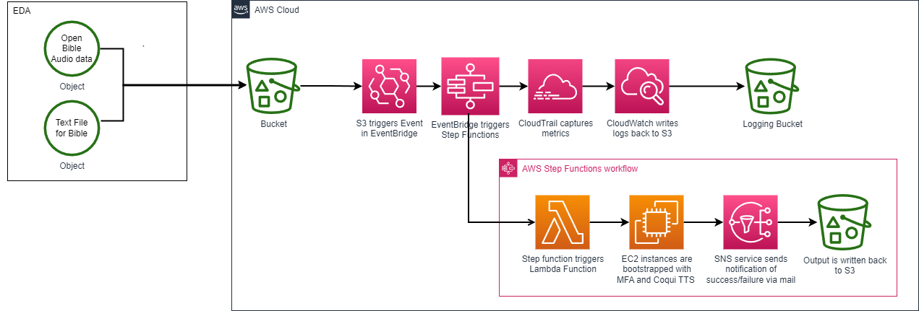
Methodological Diagram

Slide 8









AWS Architecture for the Automated Pipeline
1
2
3
4
Authorized user signs in using AWS console
User drops files in input bucket
Event Bridge connected to S3, when file drops in S3, Event is triggered
Event Bridge triggers step functions (explained on next slide)
Lifecycle policy is implemented on S3 bucket to move objects between S3 Standard > S3 one Zone IA > S3 Deep Glacier Archive
AWS IAM Identity Center (successor to AWS Single Sign-On)
Amazon S3
Amazon EventBridge
AWS Step Functions
5
Managed rule
S3 Standard
Event
S3 One Zone-IA
S3 Glacier Deep Archive

Slide 9
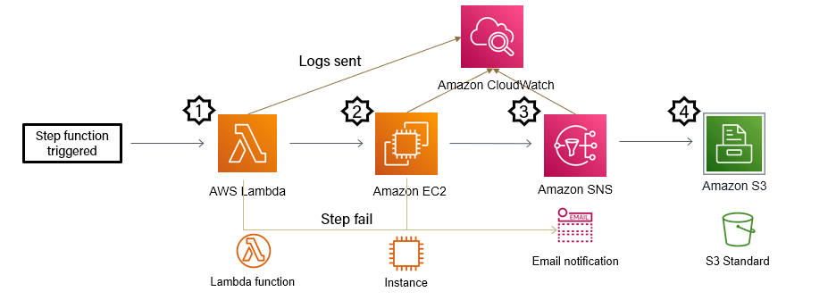
Deployment and Lifecycle Management
Step function triggers Lambda function to launch instances in EC2
Scripts are installed onto EC2 instances and executed
SNS sends out email notification to specified list for success/step failure
Output files are written back on S3, can create a folder for logs

Slide 10
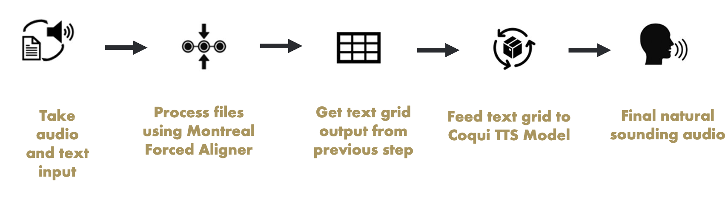
Model Building
Processing of the Speech Synthesis Model inside EC2 Instance

Slide 11
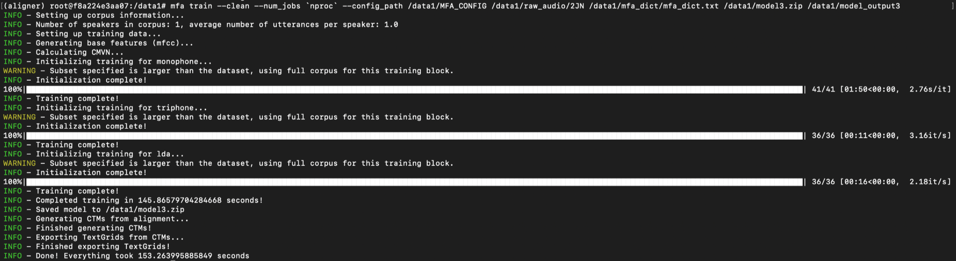
Results – Montreal Forced Aligner
Model | Time (seconds)
Monophone | 110
Triphone | 11
LDA | 16
MFA trained on speech corpus created after pre-processing
MFA runs on Docker image from Dockerhub
Training for 1 Bible chapter with 1 wave file takes 153 seconds

Slide 12
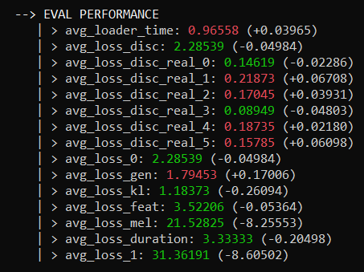
Results – COQUI TTS
Coqui TTS runs on MFA alignment data
Coqui outputs model that generate wav output files
Total TTS runtime for 20 epochs is 2 hours

Slide 13
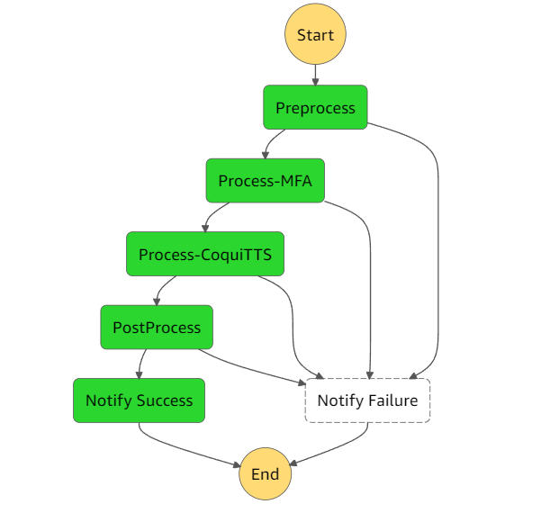
Step Function Pipeline Results
A step function has been created with multiple lambda functions as steps in it
Each Lambda will invoke and EC2 instance which will run the respective process in the machine
Each of these steps will be performed in a sequence and will send a success notification once the entire process is executed
They are engineered to send a failure notification with the failure log in-case the process fails in any of the steps

Slide 14
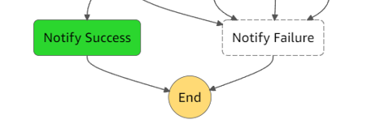
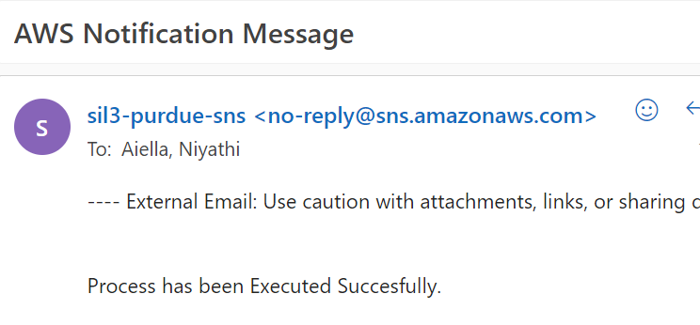
Results – Step Function SNS
The step function we created works as an automated Pipeline for the speech synthesis model that we have built on EC2 instance
This is the final notification we received indicating the success of the run of the entire pipeline.

Slide 15






Next Steps/Future Recommendations
CHALLENGES
MITIGATION STRATEGIES
Inability to use the latest MFA version
and the time-intensive nature makes MFA train the biggest bottleneck.
Engage discussions with Michael McAuliffe to update Pre-processing script to work with updated MFA
Automate pre-processing code to recognize
parameters for new languages
Build new arguments for python to recognize text file automatically as per the requirement
Scaling and concurrency issues in running
multiple language models at once
Current pipeline can only support one language transmission at a time, recreating pipeline for running concurrent languages would require new event stream

Slide 16
Thank You

Slide 17
Appendix

Slide 18





Process visualization
User uploads a file into AWS S3 bucket
AWS spins up the cluster on EC2 instance
ML Algorithms process the data by following the necessary steps in an AWS EC2 instance
Validation steps are run on top of the dataset to ensure data quality management
Processed file is written back on S3

Slide 19

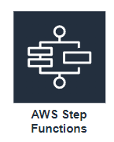
In Depth – compute services
1) Take the data from Input bucket
2) Trigger the next service
3) Drop the used data into archival bucket
4) Delete the data in Input bucket
1) Triggered through eventbridge when data falls into Input bucket
2) Trigger Lambda Function
3) Trigger EC2 instance or Sagemaker
4) Perform Preprocessing, Montreal Forced aligner, convert audio for Coqui TTS, Perform on Coqui TTS.
5) Send final data to Output S3 bucket

Slide 20
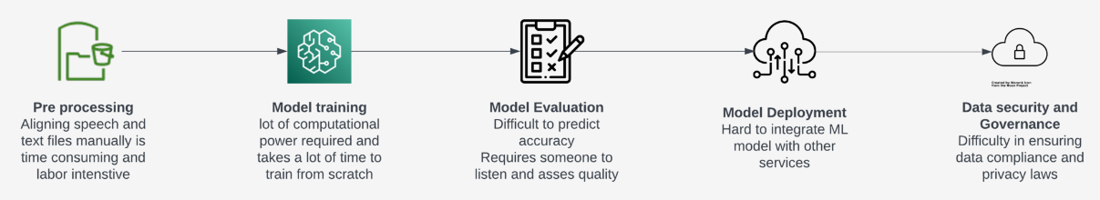
Business To Technical Problem Framing
Input Text
Coqui TTS
Speech Output

Slide 21
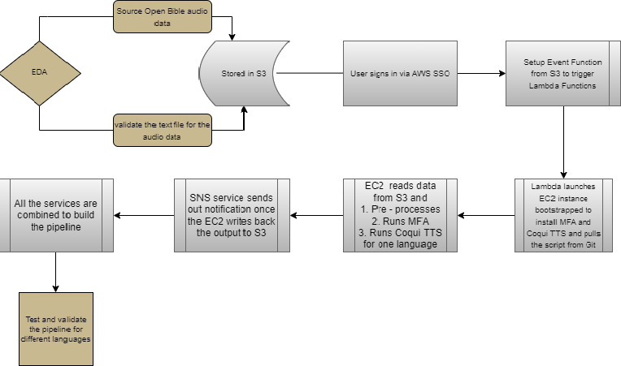
Workflow Diagram

Slide 22
Data
Hindi
Achi
Zapotec
Hausa
The TTS model is trained using data from Open Bible (https://www.openbible.info/), which provides accurate and contemporary translations.
Audio files from Open Bible are used in conjunction with text translations provided by the SIL team

